Slide 1
Capstone Project Amazon Product Review Analysis
Guided By : Dr. Nidhi Chahal
By : 1) Ankit Jain
2) Kartik Pidurkar
3) Divya Ramani

Slide 2
Contents
Project objectives
Exploratory Data Analysis
Sentiment Analysis
Forecasting Sentiment Trend
Conclusion

Slide 3

Project Objectives
Given a review, classify whether it is strong positive, positive, strong negative, negative or neutral
Reasons behind negative sentiments
Identify product names from given reviews
Predict future sentiment trends
Relation between analysed categories

Slide 4
Dataset 1: Grocery and Gourmet Food
Data Dictionary
S.No | Features | Description
1 | reviewerID | ID of the reviewer
2 | asin | ID of the product
3 | reviewerName | name of the reviewer
4 | helpful | helpfulness rating of the review
5 | reviewText | Review given by user
6 | overall | rating of the product
7 | reviewTime | time of the review (raw)

Slide 5
Dataset 2: Home and Kitchen
Data Dictionary
S.No | Features | Description
1 | reviewerID | ID of the reviewer
2 | asin | ID of the product
3 | reviewerName | name of the reviewer
4 | helpful | helpfulness rating of the review
5 | reviewText | text of the review
6 | overall | rating of the product
7 | reviewTime | time of the review (raw)

Slide 6
Raw Data Analysis using Tableau dashboard

Slide 7
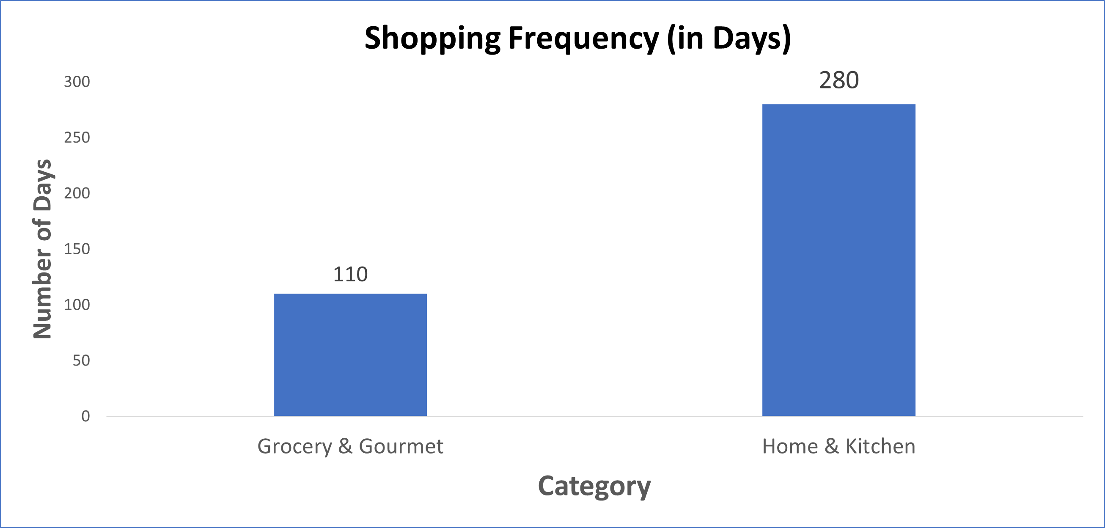
Shopping frequency analysis
Shopping Frequency Grocery- 110 Days
Shopping Frequency Home and Kitchen- 280 Days
Target for Grocery – 70 Days
Target for Home and Kitchen- 166 Days

Slide 8
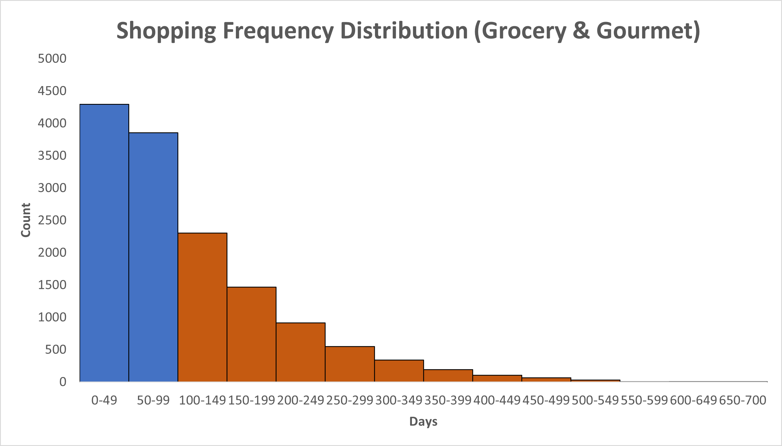
Shopping frequency analysis
Target Customer
Total Customers = 14105
Target Customers = 5352
% of Target Customer = 37.9%

Slide 9
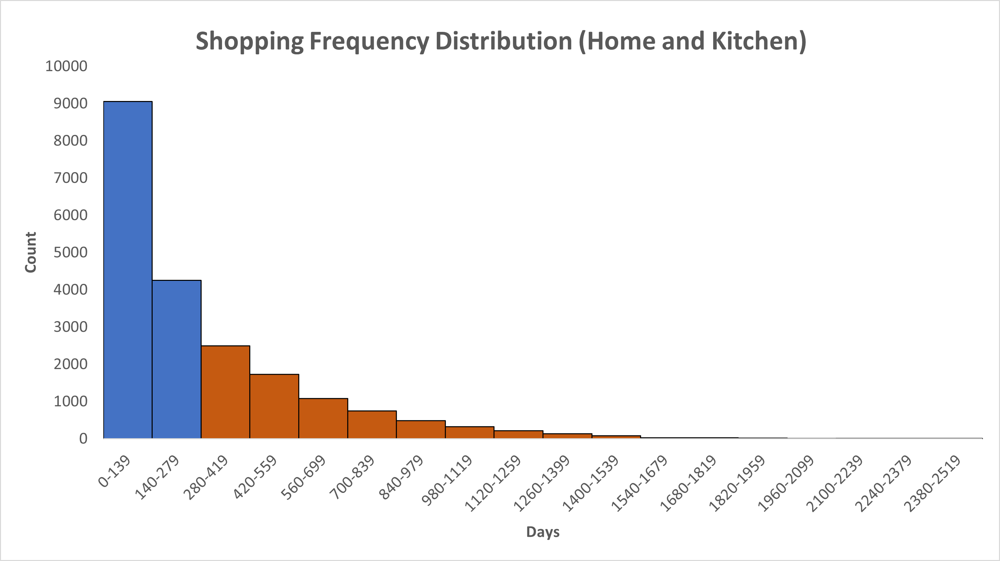
Shopping frequency analysis
Target Customer
Total Customer = 20684
Target Customer = 7359
Target Customer(%) = 35.57%

Slide 10
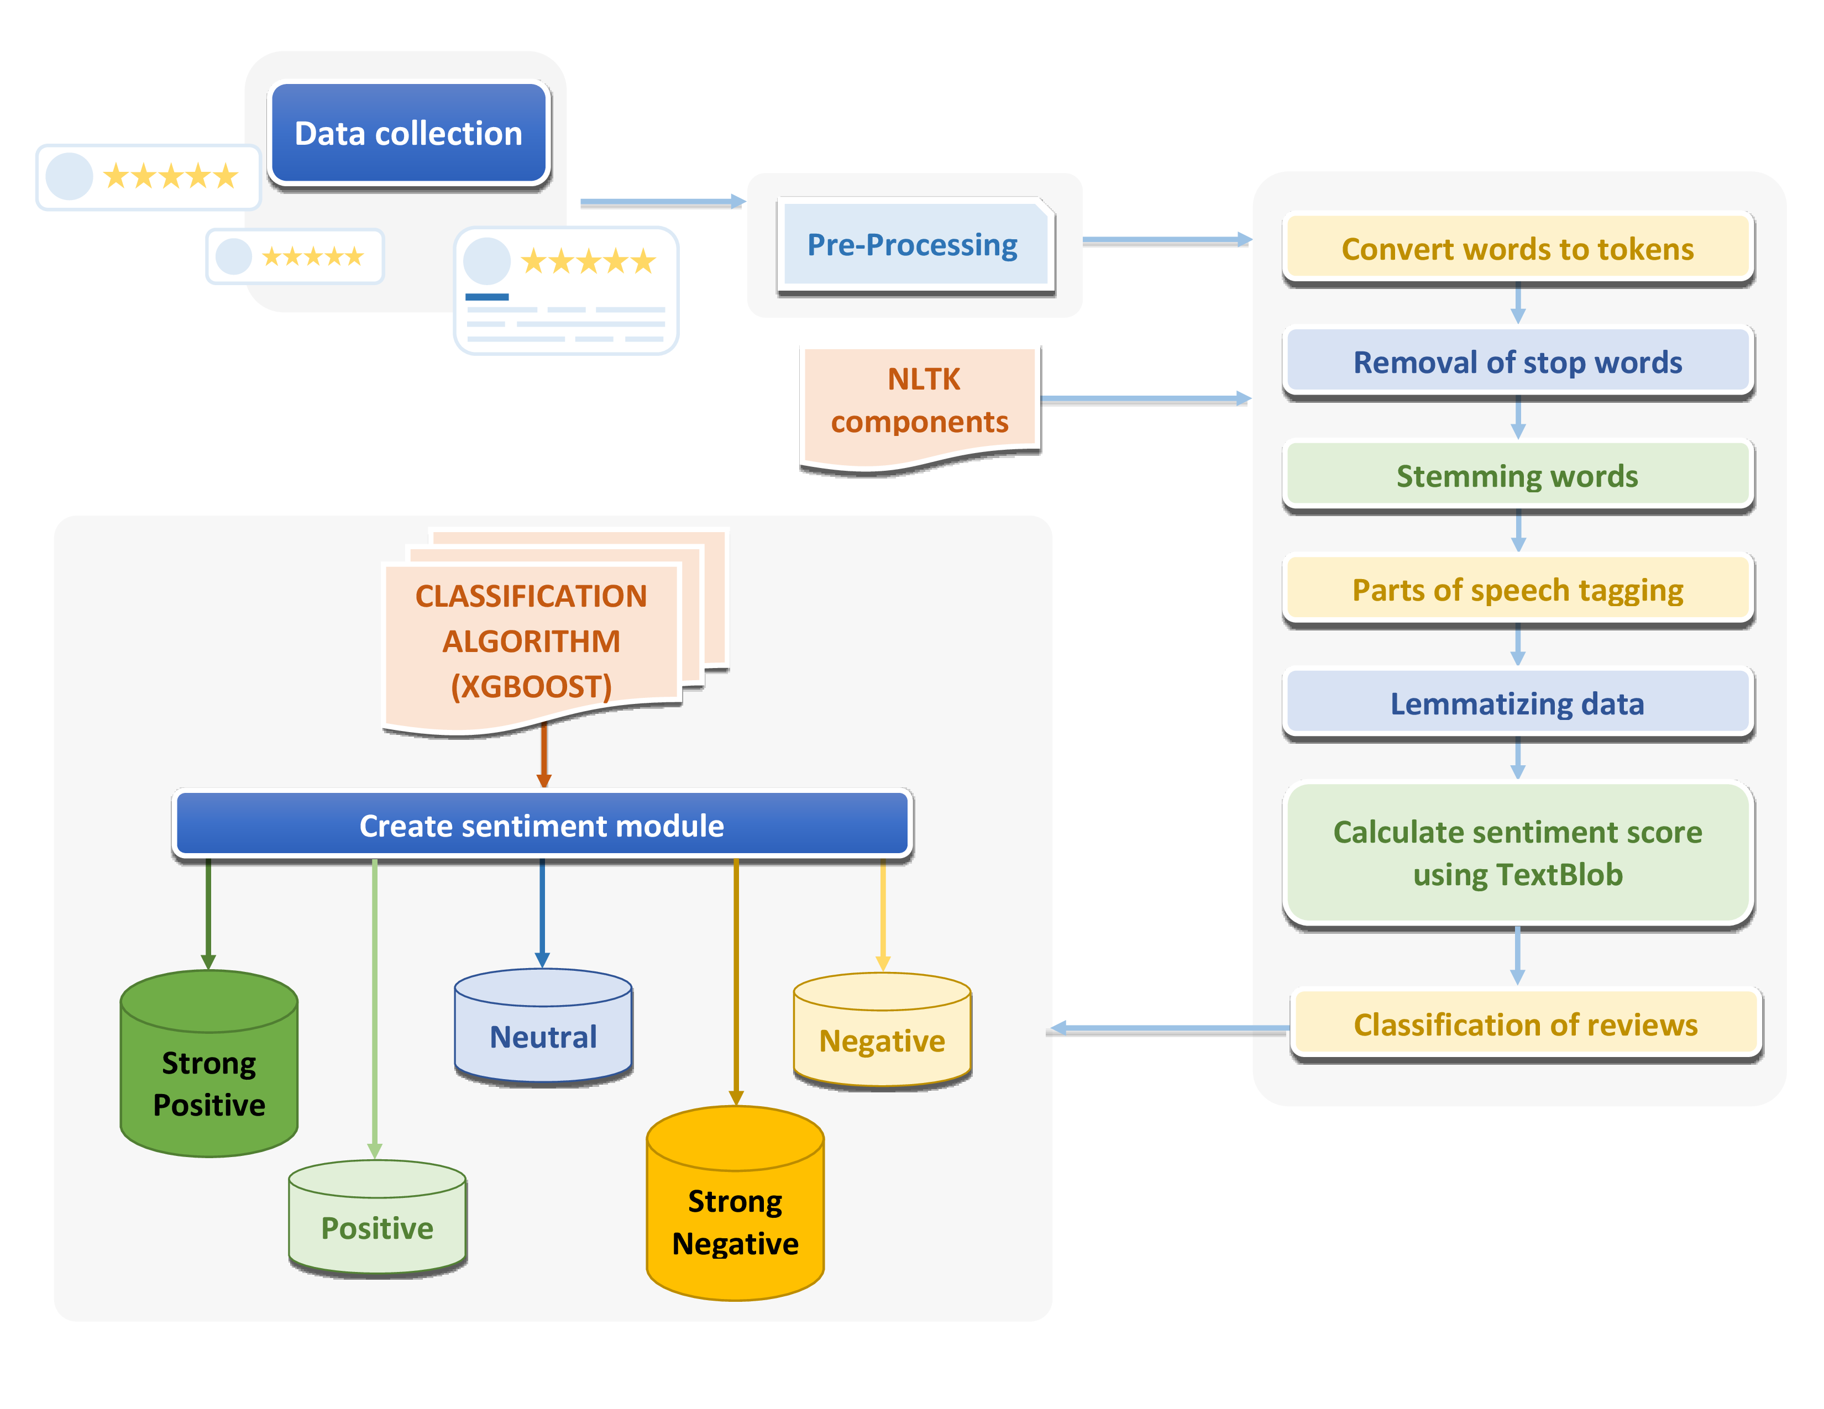
Sentiment analysis and its working

Slide 11
Model Classification
Reviews | Actual | Predicted
I had never had it before, was curious to see what it was like. Smooth, great subtle good flavor. I am ordering more and plan to make it a routine. | Positive | Positive
I used to buy these all the time, but I moved and could no longer find them at the grocery. I was excited to see them on amazon warehouse deals, but they arrived very stale. Maybe I just don't get warehouse deals and it was supposed to taste horrible? That seems wrong. Also somewhat different flavor and packaging than I remember years ago at the grocery. | Negative | Negative
I was hoping for a more interesting taste but to our family, it just tasted a bit less flavorful or weaker than the standard milk chocolate kit kat. The green tea flavor was too subtle for the sugar and it just tasted sweet. The wafers were very crispy, and that was good, but it tasted a bit anemic to us. I'm happy I bought it, but don't need to buy it again. | Neutral | Positive
This cheese made it to Afghanistan! I love cheese and being deployed that's one of the things I missed. I gave it a shot and order it and it arrived to me in perfect condition. Well packed and vacuumed sealed. Great taste!!! | Strong Positive | Strong Positive
i couldn t finish it the flavor made me sick it just tastes wrong | Strong Negative | Neutral
Review classification is done using XGBoost algorithm having weighted average f1-score is 82%

Slide 12
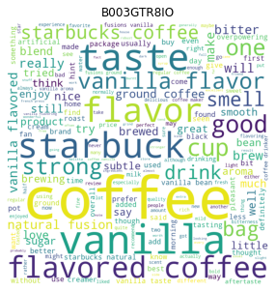
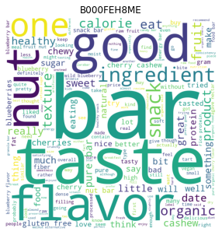
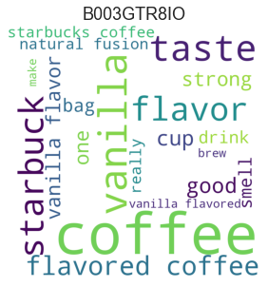
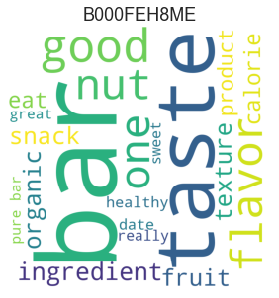
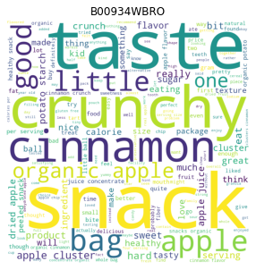
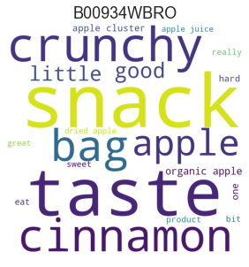
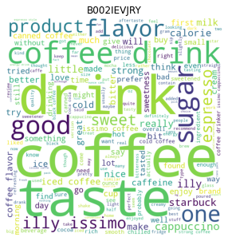
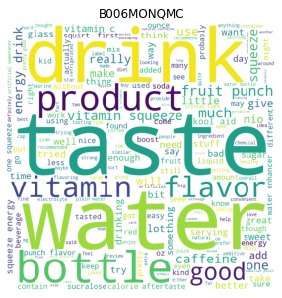
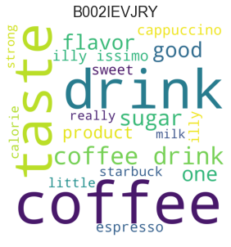
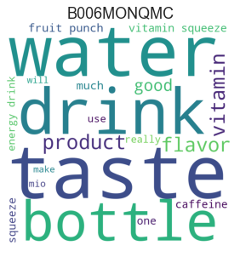
Identification of Product Name – Grocery
Vanilla Coffee
Nut bar
Apple crunchy snack
Espresso Coffee
Vitamin drink

Slide 13
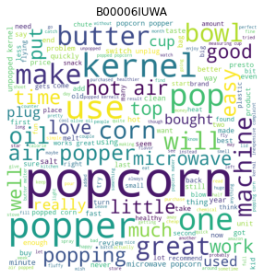
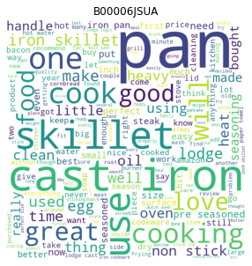
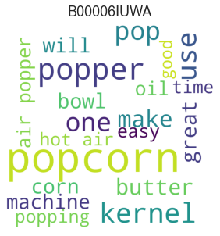
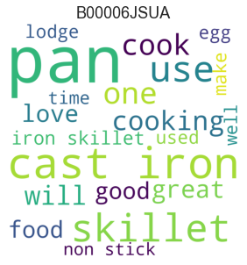
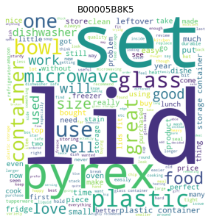
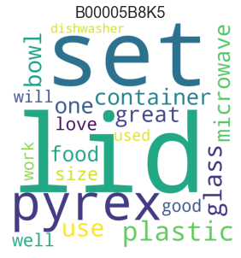
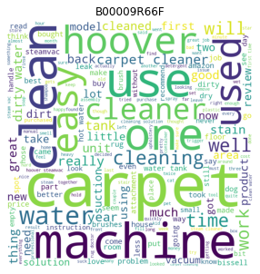
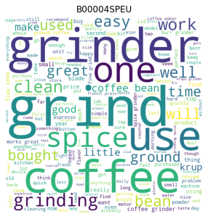
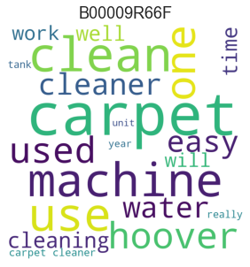
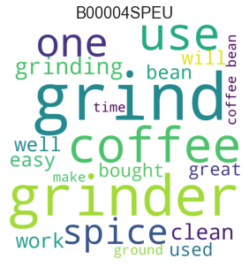
Identification of Product Name – Home & kitchen
Popcorn popper machine
Non- stick cooking pan
Bowl lid set
Carpet cleaning machine
Coffee grinder

Slide 14
Reasons behind negatively reviewed top 5 products – Grocery
Product ID | Product Name | Reasons for negative reviews
B005K4Q1YA | Coffee | Weak side flavour Artificial sweetener overbearing Taste like artificial milk Disappointed cups
B0043U63PO | Energy drink | Disgusting taste Fake flavour Really too sour Need caffeine boost
B007B9WAH4 | Green tea | Allergic lemon mixture Tastes like artificial sweeteners Sugar junkie still Berry taste undetectable
B006MONQMC | Energy drink | Weird chemical taste Lots of artificial colours Gives bad headache Smells a bit repulsive
B000UUWECC | Coconut water | Received cracked coconuts Awful taste Seller charging outrageous Found products other than coconut water
Reasons are extracted using Logistic Regression with TF-IDF vectorizer.

Slide 15
Reasons behind negatively reviewed top 5 products – Home & kitchen
Product ID | Product Name | Reasons for negative reviews
B00006JSUA | Cooking pan | Leaving yellowish mark Dishwasher rusts left Disappointed handle fell Meal metallic taste
B0000VLU62 | Cutting board | Surface scratches easily Wish little thicker Creates dents on boards Board flimsy
B0000CFMZN | Measuring cup | Pour leaks Little heavier than before High price Difficulty reading measurements
B00006IUWA | Popcorn popper machine | Motor burnt quickly Trouble getting replacement Fake butter taste Sparks every time
B00005IBX9 | Coffee maker | Found hairline crack Metal actually plastic Fussy making coffee Started coming flames
Reasons are extracted using Logistic Regression with TF-IDF vectorizer.

Slide 16
Sentiment analysis using tableau dashboard

Slide 17
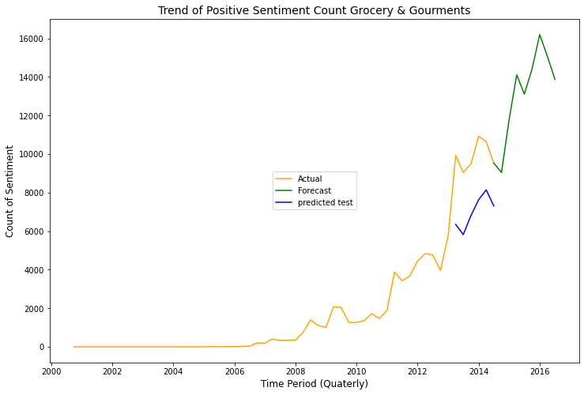
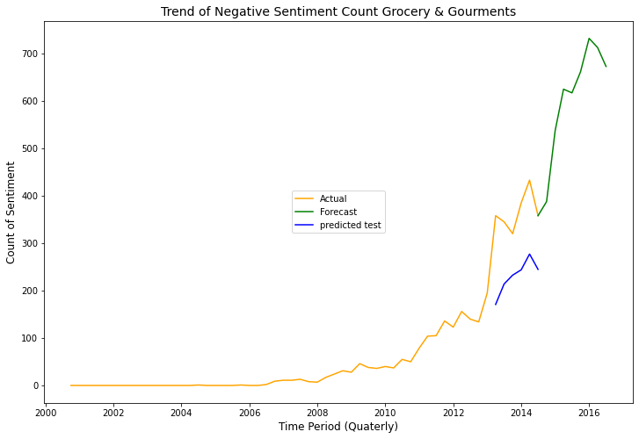
Forecasting sentiment trend – Grocery
Forecasting of sentiment count is done using ARIMA model. Using 70:30 Train :Test Sample ratio.
Positive and Negative reviews for the Grocery and Gourmet category are expected to rise in the upcoming years.

Slide 18
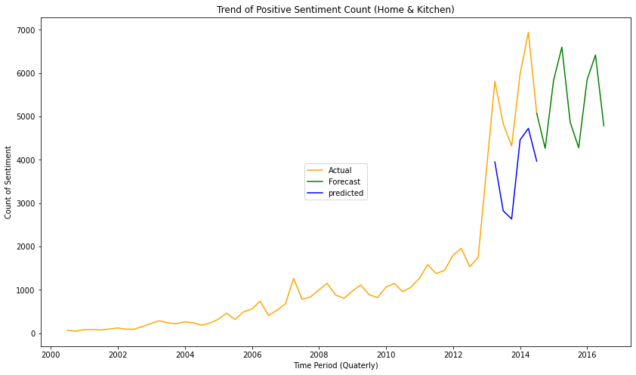
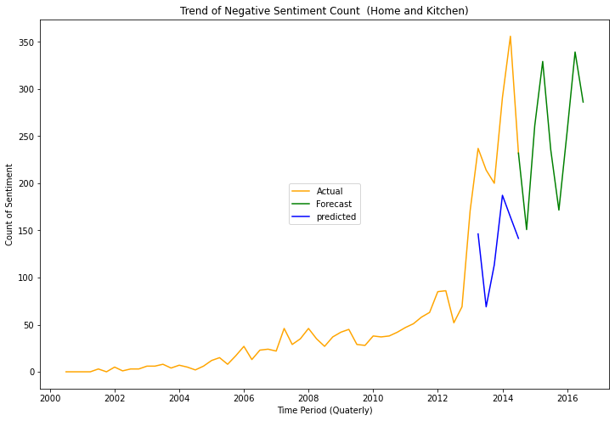
Forecasting sentiment trend – Home & kitchen
Forecasting of sentiment count is done using ARIMA model. Using 70:30 Train :Test Sample ratio.
Positive and Negative reviews for the Home and Kitchen category they are expected to be in same range.

Slide 19
Inter-category analysis
For every group of 100 customers only 15 of them shop from both the categories i.e., Grocery & Gourmet and House & Kitchen
For every 100 products bought from the Grocery and Gourmets Category, nearly 6 products are bought from the House and Kitchen Category
Products bought from Grocery | No. of products also bought from Home & Kitchen
Bakers Baking Spray, 5 Oz (Pack of 3) | 11
Wilton Bake Easy Non-Stick Spray | 11
Nordic Ware Bakers Joy Non-Stick Spray | 10
Hoosier Hill Farm Clear Jel | 9
Wilton 704-0162 Crumb Coat Spray | 8

Slide 20
Most reviewed products of both categories
Grocery and Gourmet food | Home and Kitchen
bar nut | non-stick cook pan
espresso coffee | popcorn popper machine
apple crunchy snack | bowl lid set
Vitamin drink | carpet cleaning machine
vanilla coffee | coffee grinder
ginger lemon tea | glass cup
chicken meal cheese hamburger | coffee maker
vanilla tea | oil spray
ginger cardamom tea | coffee mug
chocolate caramel candies | knife

Slide 21
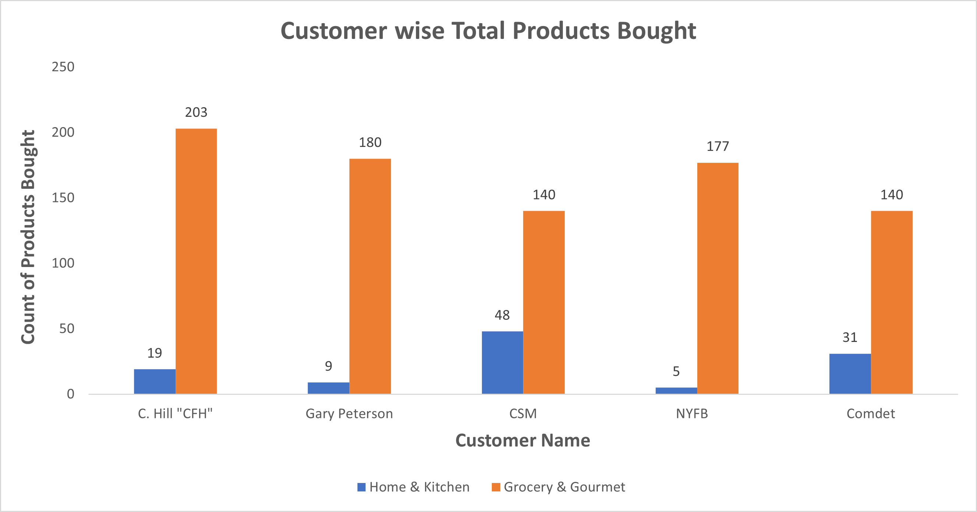
Relation between both categories
94.28 % of the customers shopping from the both the categories , buy more products from the GG category.

Slide 22
conclusions
Nearly 80% of customers are happy buying products from amazon
Over the years it has been observed that people are not finding reviews helpful
People write lengthy reviews when they are not satisfied
Positive and Negative reviews are expected to be in same range (Grocery) or rise (Home & Kitchen) in upcoming years

Slide 23
Thank you

